Slide 1









A DEEP DIVE INTO
MACHINE LEARNING ALGORITHMS
SIMULATION AND DATA VISUALIZATION
TEAM 1
RENATA QUINTERO JORGE CARDENAS MARCO ANTONIO MENDOZA

Slide 2








WHAT ALGORITHMS WILL WE BE COVERING?
01
02
03
LOGISTIC REGRESSION
MULTILINEAR REGRESSION
POLYNOMIAL REGRESSION

Slide 3




WHAT IS MACHINE LEARNING?
“Machine learning (ML) is a branch of artificial intelligence (AI) focused on enabling computers and machines to imitate the way that humans learn, to perform tasks autonomously, and to improve their performance and accuracy through experience and exposure to more data.”
– IBM

Slide 4
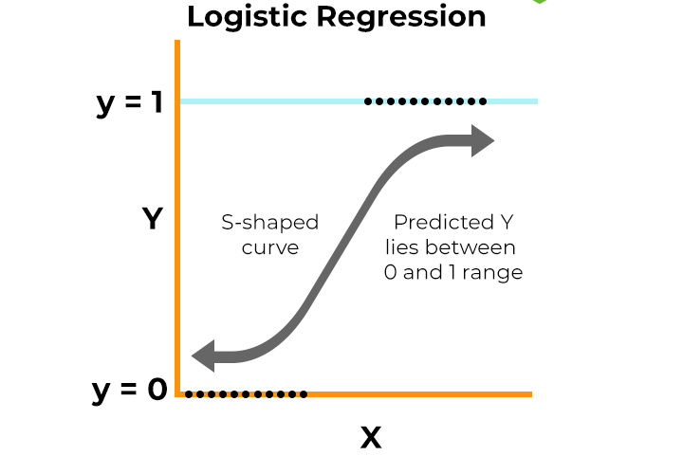
LOGISITIC REGRESSION
Logistic Regression is a supervised learning algorithm used for binary classification tasks, where the outcome is either 0 or 1 (e.g., yes/no). It uses the logistic (sigmoid) function to model the probability of a data point belonging to a certain class. It assumes a linear relationship between the input variables and the log-odds of the outcome, making it fast, interpretable, and effective for problems like medical diagnosis, fraud detection, and marketing predictions.

Slide 5
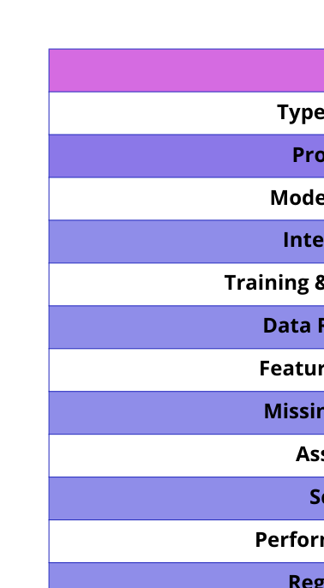
STATISTICS

Slide 6

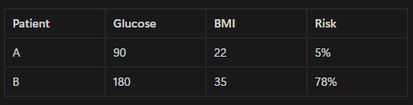
EXAMPLE
▶️Example: Diabetes Prediction model
Imagine doctors want to predict whether a patient is at risk of diabetes based on simple health data. Logistic regression helps by calculating the probability (0% - 100%) of having the disease using factors like: Glucose level, BMI, and family History.
The algorithm takes those inputs, weights them (e.g. glucose matters more than age), and returns a risk score (e.g. 75% chance of diabetes). Doctors then can set a threshold, for example, 50%: above = high risk, below = low risk.

Slide 7
PROS & CONS
Why use Logistic Regression in this Industry?
✔️Pros
⭐Interpretability - It shows exact impact of risk factors (e.g., smoking - lung cancer).
⭐Probabilistic outputs - Provides risk scores, aiding clinical decisions.
⭐Handles mixed data types - It works with numerical (age, lab values) and categorical (gender, smoker) data.
❌Cons
⭐Linear desicion boundary - Struggles with complex nonlinear patterns.
⭐Class imbalance issues - Struggles without the proper techniques Poor performance on rare diseases.
⭐Feature engineering needed - Requires handling missing data, scaling and encoding categorical variables.

Slide 8
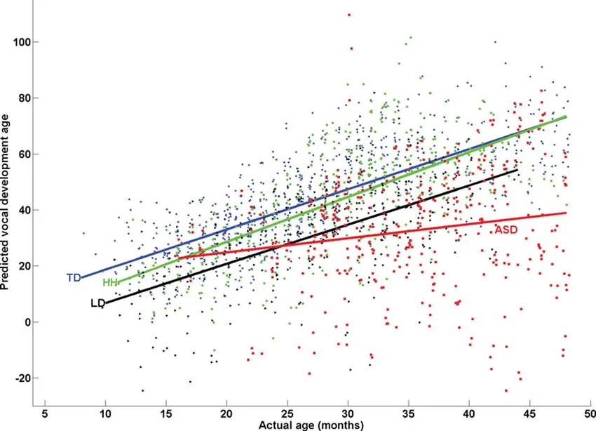
MULTILINEAR REGRESSION
Multilinear Regression is a regression algorithm that predicts a continuous value based on two or more independent variables. It fits a linear equation to the data to explain how multiple factors influence a single outcome. It assumes relationships are linear and errors are normally distributed. This method is widely used in fields like real estate pricing, business forecasting, and social science research due to its simplicity and explanatory power.

Slide 9

STATISTICS

Slide 10

EXAMPLE
▶️Example: Predicting delivery delays
Imagine you’re running a shipping company and you want to estimate the delay that package delivery might have. Multilinear regression helps predict those delays by analyzing some factors like: Distance in km, weather severity (in a 1 to 5 scale), and the carrier type.
The algorithm takes those inputs and calculates their combined effect, for example:
Every 100 km adds about 0.2 days to delivery time. Bad weather (score 4/5) adds 1.5 days. Premium carriers can reduce delays by 0.8 days

Slide 11
PROS & CONS
Why use Multilinear Regression in this Industry?
✔️Pros
⭐Interpretability - Quantifies how each factor impacts outcomes like delay or costs.
⭐Cost-effective - Requires less data power vs. AI models (e.g. neural networks)
⭐Scenario testing - Simulate “what if” scenarios, for example, how does a fuel price hike affect costs?
❌Cons
⭐Assumes linearity - Fails if relations are nonlinear (e.g. demand spikes during holidays) .
⭐Sensitive to outliers - Extreme events like fuel cost and labor cost distort coefficients.
⭐Static model - It doesn’t auto adapt to trends (e.g. post pandemic demand shifts).

Slide 12
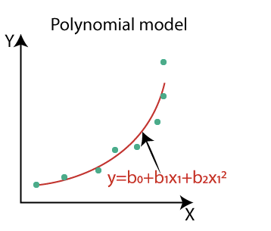
POLYNOMIAL REGRESSION
Polynomial Regression is used when the relationship between variables is non-linear. It extends linear regression by adding higher-degree terms (like x², x³) to model curves in the data. While it offers more flexibility than linear models, it can be prone to overfitting if the degree is too high. It’s commonly used in fields like finance, robotics, and engineering to capture complex trends.

Slide 13

STATISTICS

Slide 14
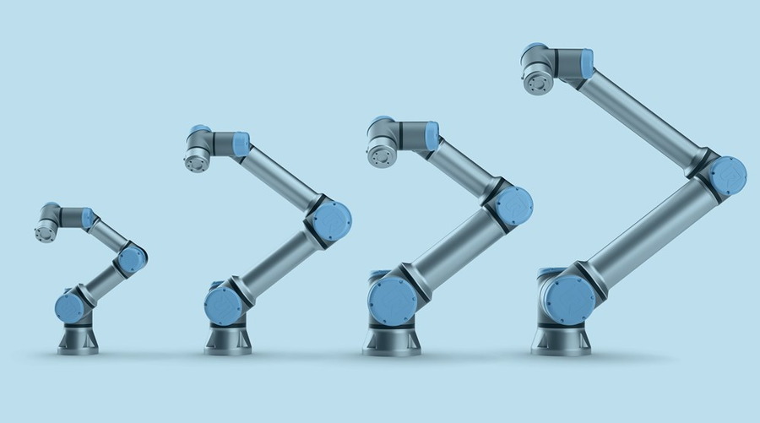
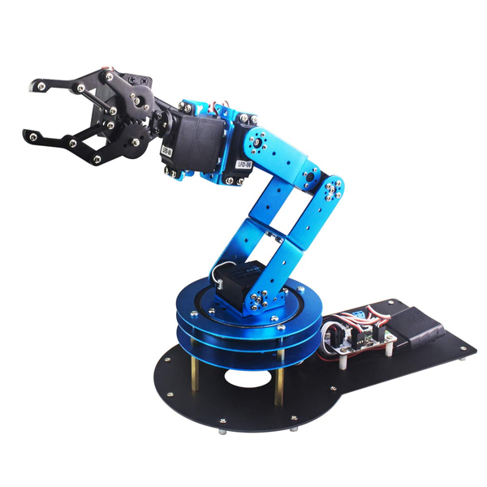
EXAMPLE
▶️Example: Robotic arm trajectory
Imagine that you are programming a robotic arm to smoothly do movements. Straight moves can look unnatural; that’s where polynomial regression helps create curved motions that mimic how human arms move.
How’s the robot’s motion calculated? Let’s assume that the arm’s position is determined by this equation: 0.5t - 0.1t² + 0.02t³
The first term (0.5t) controls the arm’s starting speed. The second term (- 0.1t²) adds gradual acceleration/deceleration. And the third term (0.02t³) makes the movement extra smooth.

Slide 15
PROS & CONS
Why use Multilinear Regression in this Industry?
✔️Pros
⭐Smooth motion - Avoids abrupt stops/starts
⭐Computational efficiency - Faster than complex models for real time control
⭐Tunable precision - Adjust polynominal degree to balance accuracy/speed
❌Cons
⭐Static Modeling - Assumes fixed dynamics, meaning that the model won’t reoptimize unless it’s part of a larger adaptive system.
⭐Sensitive to noise - Sensing errors distort predicted paths.
⭐Only for simple robots - Struggles with bigger robots (100+ joints)

Slide 16
CONCLUSION
These algorithms are essential tools in Machine Learning, each suited for different types of problems. Whether it’s classifying outcomes, predicting continuous values, or modeling complex patterns, they offer a balance between simplicity and usefulness. Understanding how and when to apply them provides a strong foundation for solving real-world problems in areas like healthcare, finance, business, and engineering.

Slide 17
THANK YOU!

